Slide 1

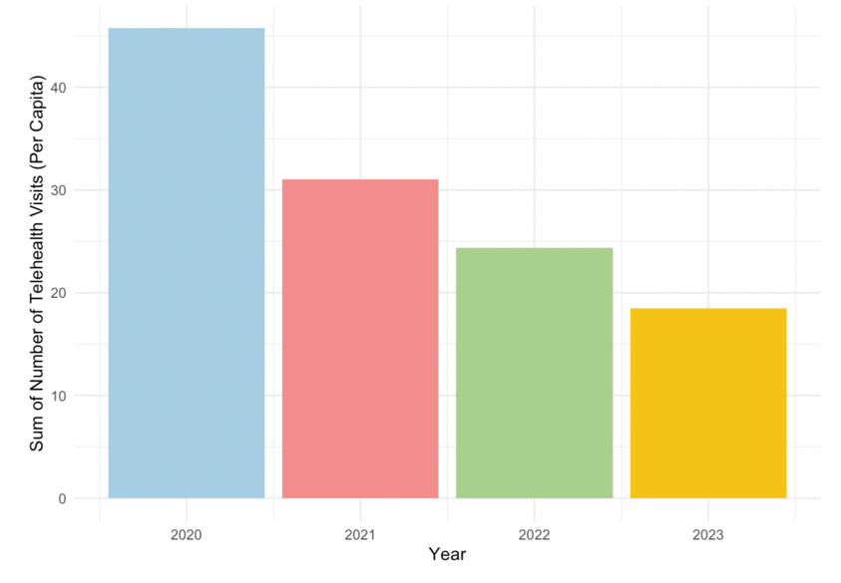
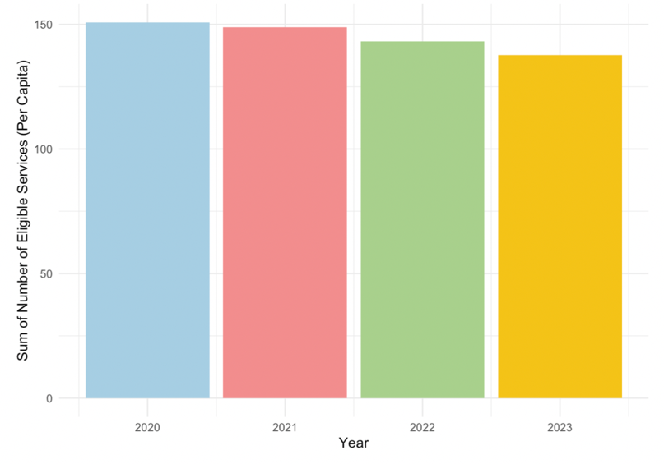
Factors impacting the use of telehealth for Medicare and Medicaid members in 2020-2024
Jessica Coomber
Data Analytics 401
Introduction
Research Aim:
Understand the factors impacting the use of telehealth visits for Medicare and Medicaid members
Dataset:
Medicare Telehealth Trends dataset (CMS)
Publicly available data from US Census Bureau
The Transit Report Card from Transportation for America
Fixed Effect Analysis:
Used to assess the relationship between the variables and the number of telehealth visits per capita, while controlling for state and year.
Implications:
Used to understand potential socioeconomic barriers to telehealth access
Aid opportunities for targeted interventions to improve equitable access to care.
Results
Figure 1 shows the number of telehealth services was the highest in 2020 because the pandemic forced almost all in person visits to become virtual.
Figure 2 suggests that since 2020 there has only been a small decline in the number of services that are eligible for telehealth use.
This research will provide insight into:
The ways that the use of telehealth services can increase
Which populations are currently lacking versus accessing those eligible services.
Table 1: State and Year Fixed Effects on Various Factors impacting the Number of Telehealth Visits (Per Capita)
Table 2: Variance Inflation Factors (VIF)
Variable | No Fixed Effect | State Fixed Effect | State and Year Fixed Effect
Vehicles Owned | 0.066** | 0.121*** | 0.122***
 | (0.009) | (0.021) | (0.021)
Transit Spending Per Capita | 0.000*** | 0.005*** | 0.005***
 | (0.000) | (0.001) | (0.001)
With Internet | -0.076*** | -0.108*** | -0.103***
 | (0.009) | (0.013) | (0.014)
Number of Hospitals | -45.313*** | -1670.351*** | -1657.032***
 | (5.089) | (323.434) | (323.677)
Number of Physicians | 2.211*** | 92.439*** | 93.079***
 | (0.213) | (14.899) | (14.912)
Percent Below Poverty Level | -0.025*** | -0.022 | -0.021
 | (0.003) | (0.015) | (0.015)
Num.Obs. | 19330 | 19330 | 19330
State Fixed Effects | No | Yes | Yes
Year Fixed Effects | No | No | Yes
R2 | 0.092 | 0.139 | 0.139
Variable | VIF
Vehicles Owned | 7.70
With Internet | 6.55
Number of Physicians | 2.09
Hospitals Count | 1.75
Transit Spending Per Capita | 1.69
Percent Below Poverty Level | 1.66
Results
<5 suggests low multicollinearity
Which is better for a multivariate fixed effect model
Table 2 variables are mostly low so coefficients in the Fixed Effect are accurate and reliable.
Figure 1: Telehealth Visits by Year
Discussion
There are eligible services which have the potential for increase access with the use of telehealth
Several key factors influencing telehealth usage have been identified in the fixed effect model
The use of telehealth by Medicare and Medicaid members is affected by more than just whether internet is available
There are many factors representing economic status, appointment access, and technology access
Medicare and Medicaid members in this study represents a population who is facing more economic and technological barriers
Further research should be done on populations included other levels of insurance coverage.
Methods
A fixed effect analysis is used to assess the association between various variables and the number of telehealth visits while controlling for state and year.
Fixed effect models control for time invariant variables and in this case controls for differences between states and years.
Variables are chosen for the fixed effect model:
The Number of Vehicles Owned
Transit Spending Per Capita
Having Internet Access
Number of Hospitals
Number of Physicians
Poverty Level
Evaluate the fit of the model:
R^2 represents how well the model explains variation within each fixed-effect group.
Variance Inflation Factor (VIF) analysis:
Test for multicollinearity, which is when independent variables are highly correlated with each other.
If there is multicollinearity in the fixed effect model then the variables could be capturing overlapping aspects of economic status.
Note: Statistical significance for coefficients is shown by *p < 0:10 **p < 0:05 ***p < 0:01 ****p < 0:001. Standard Errors are included in parenthesis.
Results
R^2
No fixed effect R^2 = 0.092. (Number of telehealth visits is explained little by the variables)
With fixed effect R^2 = 0.139 (Explains more of the variation)
Vehicles Owned
Higher number of vehicles owned is associated with more telehealth visits.
Likely better financial status and accessibility to resources
Transit Spending
Higher amount spent on transit is associated with more telehealth visits.
Likely urban areas which have greater access to high speed broad band internet compared to rural areas (Ching-Ching, 2018).
Internet access
Surprisingly more internet is associated with fewer telehealth visits.
Widespread access, 95% of U.S. households have at least one type of computer (Liu, 2024).
Number of Hospitals and Number of Providers
More hospitals is associated with less telehealth. (More in person availability but they have potential to be done as a telehealth visit (Ashwood, 2017). )
More providers is associated with more telehealth (More appointment availability)
Percent below poverty level
Higher poverty is associated with fewer telehealth visits
Figure 2: Eligible Services
(With Potential for Telehealth Use) by Year
Works Cited
Ashwood, J. and Mehrotra, Ateev and Cowling, David and Uscher-Pines, Lori. (2017). Direct-to-consumer telehealth may increase access to care but does not decrease spending. Health Affairs, 36(2)https://doi.org/10.1377/hlthaff.2016.1130
CMS Program Statistics - OEDA (2025). Medicare Telehealth Trends. [Data set]. Centers for Medicare & Medicaid Services. https://catalog.data.gov/dataset/medicare-telemedicine-snapshot
Ching-Ching, Claire Lin et al.. (2018). Telehealth in health centers: Key adoption factors, barriers, and opportunities. Health Affairs, 37(12) https://doi.org/10.1377/hlthaff.2018.05125

